Slide 1
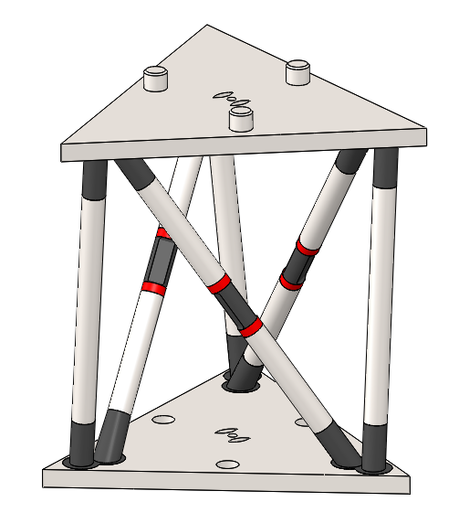
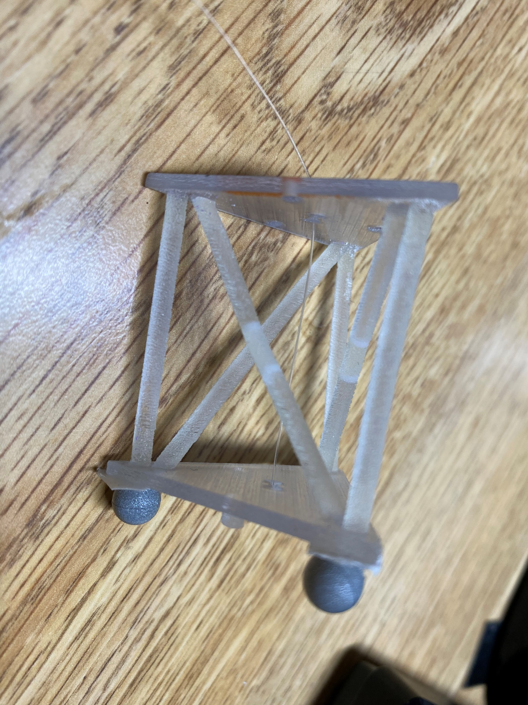
Structural design of the module
3D-printed version of the building block
(VeroWhitePlus+Agilus30)
top plate
Printed module
The bottom plate is fixed.
The six soft joints on the plates are always soft (30A).
When pulling the cable downward, we can get different trajectories and eventual orientations of the top plate, which are determined by the stiffnesses of the three diagonal soft joints.
diagonal soft joint X3
diagonal links X6
vertical links X3
soft joints on the plates X6
bottom plate
cable

Slide 2
Main function: recursive_flow
Search for the new bs (step_energy).
Objective: minimum potential energy (potential_energy_addsup)
Constraints: the cable length decreased by 0.1mm （ step_Constraints_addsup）
Initialization of the geometry(recursive_flow)
Update the geometry (step).
Get thetas from bs.
Get geometry from thetas.
Get g (the transformation vector used for plotting)
Plotting after simulation finished (moduleplot)

Slide 3
We can set the stiffness to be :
stiffness=[0.3242,0.664,300]’; % 0.3242 is the Young’s modulus of material 30A
% 0.664 is the Young’s modulus of material 70A
% 300 is arbitrarily chosen to represent the Young’s modulus of rigid part
stiffness=repmat(stiffness,4,1); % set the stiffnesses of four modules to be identical
% 4 indicate the number of modules
Call the function:
[g_out,jiaodu,bs_vector,fval2_vector]=recursive_flow(r,k,phi, S,final_displacement, n_iter)
[g_out,jiaodu,bs_vector,fval2_vector]=recursive_flow(17.8979,32/17.8979,10/180*pi, S,final_displacement, n_iter);
% 17.8979 is the value of r
% 32/17.8979 is the value of k (the ratio of height (h) to r)
% 10/180*pi is the value of (initial rotation angle)
% S is the stiffnesses of all the diagonal joints. Number of entries in this vector is determined by 3 X N (number of modules).
% final_displacement is the displacements of the three cables.
% n_iter is the number of steps of iterations. Can be 2, 5 , 10, etc.
% bs_vector is the required output, indicating the lengths of all the diagonal links.

Slide 4
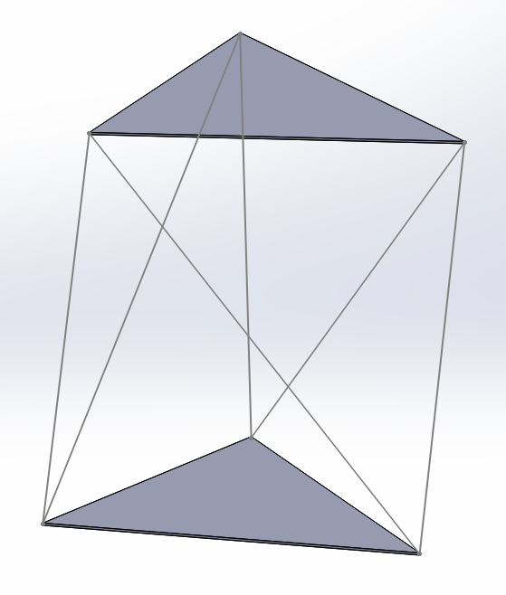
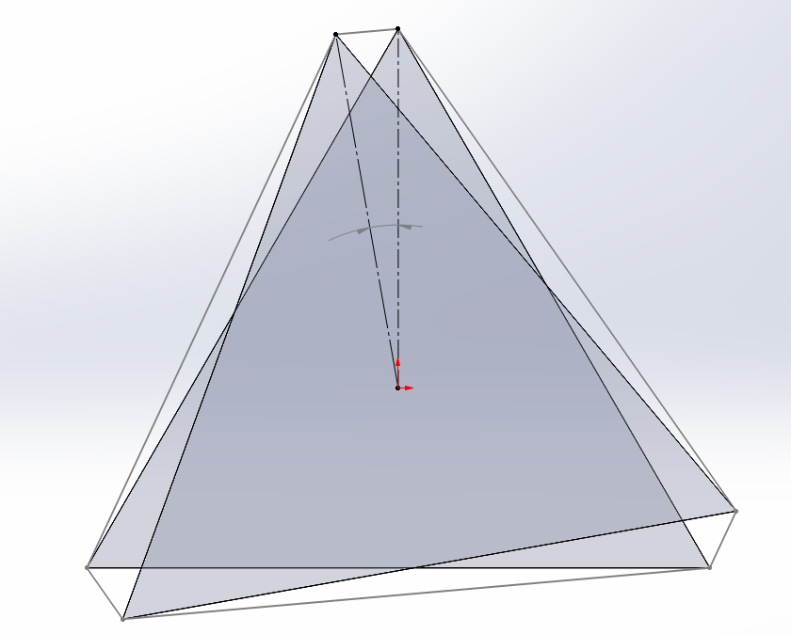
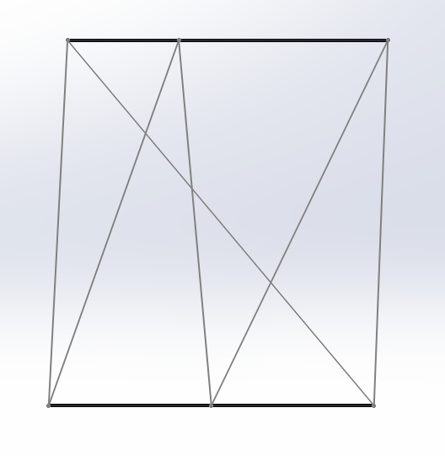
Simplified geometry used in the code
$∅$
r
as
l
bs
l
as is the length of the three vertical rod. (3 X 1 vector, constant)
bs is the length of the three diagonal rod. (3 X 1 vector, variable)
l is the length of the side of the equilateral triangular plate. (scalar constant)
is the initial rotating angle of the top plate, with respect to the fixed bottom plate. (scalar constant)
r is the perpendicular distance from the center of triangular plate to the side. (scalar constant)
h is the initial height of the module (distance between the top and bottom plate). (scalar constant)
k is the ratio of h to r. (scalar constant)
h=r*k

Slide 5
N is 3, the number of sides of the triangular plate.

Slide 6
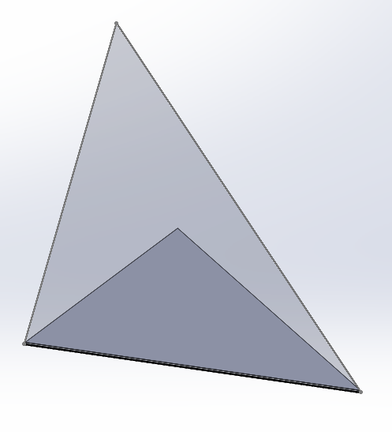
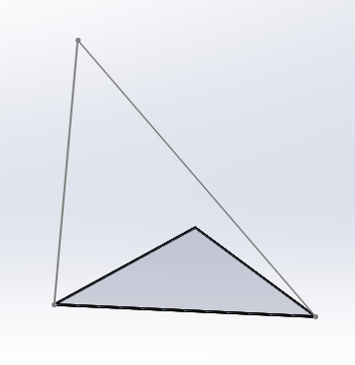
Geometrical relations used in the code
A
A
A
as
bs
$A^{′}$
$A^{′}$
$A^{′}$
B
C
B
C
l
B
C
theta is a 3 X 1 vector, each entry corresponding to a dihedral angles (the dihedral angle between planes ABC and .

Slide 7
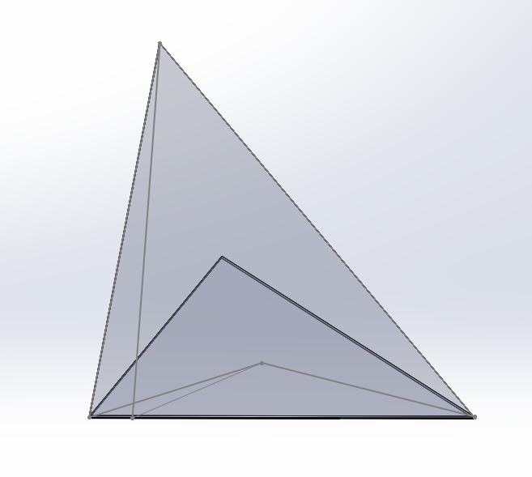
How to use theta to locate the vertex A?
If we denote by:
: the ratio of BD to BC
: the ratio of AD to BC
: vector OC
: vector OB
q : vector OD
: unit vector along BC
H: unit vector along DA
: rotation matrix, angle theta
along the axis
P: position of the vertex A
Then, we can have:
A
O is the centroid of the bottom plate.
AD is perpendicular to BC
$A^{′}$
O
B
C
D

